Slide 1

The Early Years Foundation Stage [EYFS]
Heighington C of E Primary School

Slide 2

‘Life in all its fullness’ (John 10:10)
As a village school, we acknowledge our role in our community. Our curriculum is constantly evolving, responding to the needs of our learners and their interests by enhancing learning experiences and raising awareness from our local area to national and global arenas.
Staffing & Organisation
At Heighington Primary School we have one Nursery class, which opened in September 2024, and one Reception class.
Nursery class teacher: Sophie Lockey
Nursery teaching assistants: Julie Jackson and Lauren Jackson
Reception class teacher and EYFS lead: Kate Timmins
Reception class teaching assistant: Nadine Smith
Children have previously come to our Reception class from a range of local pre-school settings and nurseries.

Slide 3

Learning in the EYFS
Play, Scaffolding, Modelling, Observing, Guided Learning, Direct Teaching
In our classroom, you may see children playing alone or with their peers, deciding on resources and choosing how to spend their time. You may see a child playing and listening to an adult, who is modelling how to achieve something or teaching a new skill that interests the child.
Adults may scaffold a child’s play. This involves taking their play to higher levels of learning, entering the play as a co-creator and helping to provoke a framework for the children to go from “what they know” to “what else they could know”. Scaffolding enables a child to solve a problem, carry out a task or achieve a goal which is just beyond his or her abilities. During play, where foundational social and emotional skills are developed, scaffolding is a bridge to new skill levels using three key ingredients; modelling the skill, giving clues and asking questions while the child is trying out a new skill, and then as the child approaches mastery, withdrawing the support.
The EYFS statutory framework does not prescribe a particular teaching approach.
“Play is essential for children’s development, building their confidence as they learn to explore, relate to others, set their own goals and solve problems. Children learn by leading their own play, and by taking part in play which is guided by adults.”
At Heighington Primary School, the EYFS lead carefully plans what the children learn in the classroom and through provision enables them to learn from their interests, alongside extending their knowledge and understanding through direct teaching.
Each day, we stimulate children’s interests, respond to each child’s emerging needs and guide their development through warm, positive interactions coupled with secure routines for play and learning.
As the children develop and their skills progress throughout the reception year, we use more direct teaching and modelling and plan specific sequences of lessons. These strategies help us to focus on teaching the essential skills and knowledge in the specific areas of learning so that the children can develop the skills and confidence required for the end of their reception year.

Slide 4

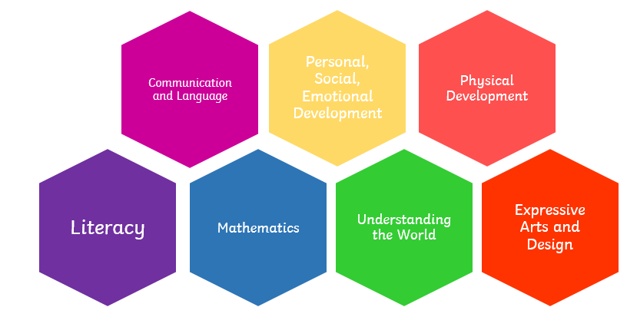
EYFS Statutory Framework
Characteristics of Effective Learning describe behaviours children use in order to learn. To learn well, children must approach opportunities with curiosity, energy and enthusiasm. Effective learning must be meaningful to a child, so that they are able to use what they have learned and apply it in new situations. These abilities and attitudes of strong learners will support them to learn well and make good progress in all the Areas of Learning and Development.
The three characteristics of effective teaching and learning are:
• Playing and exploring – children investigate and experience things, and ‘have a go’.
• Active learning – children concentrate and keep on trying if they encounter difficulties, and enjoy achievements.
• Creating and thinking critically – children have and develop their own ideas, make links between ideas, and develop strategies for doing things.
Areas of Learning and Development
Prime areas of development and learning lay vital foundations in the early years. The three prime areas are: Communication and Language, Personal, Social and Emotional Development and Physical Development. The four specific areas are: Literacy, Mathematics, Understanding the World and Expressive Arts and Design which build on the development gained through the prime areas.

Slide 5
When we give every child the best start in their early years, we give them what they need today. We also set them up with every chance of success tomorrow.
Development Matters [DfE, 2021]

